Slide 1
The Importance of Having a High NBA Draft Pick
Presented by: Victor, Jesús and Carlos
Date: September 3rd, 2022

Slide 2
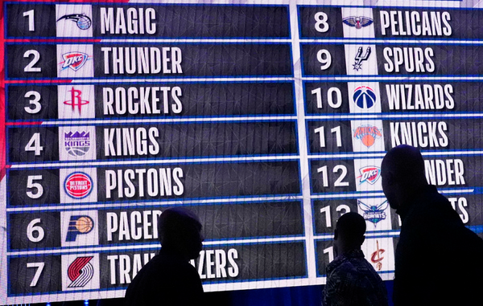
Table of Contents
The NBA Draft
The Goal
The Data
Analysis
Conclusion

Slide 3

The NBA Draft
The NBA draft is an annual event dating back to 1947 in which the teams from the National Basketball Association (NBA) can draft players who are eligible and wish to join the league
These are typically college basketball players, but international players are also eligible to be drafted

Slide 4
The Goal
Identify if first positions on the Draft selection predicts a successful basketball career
Is it worthwhile to have a selection among the first positions?

Slide 5
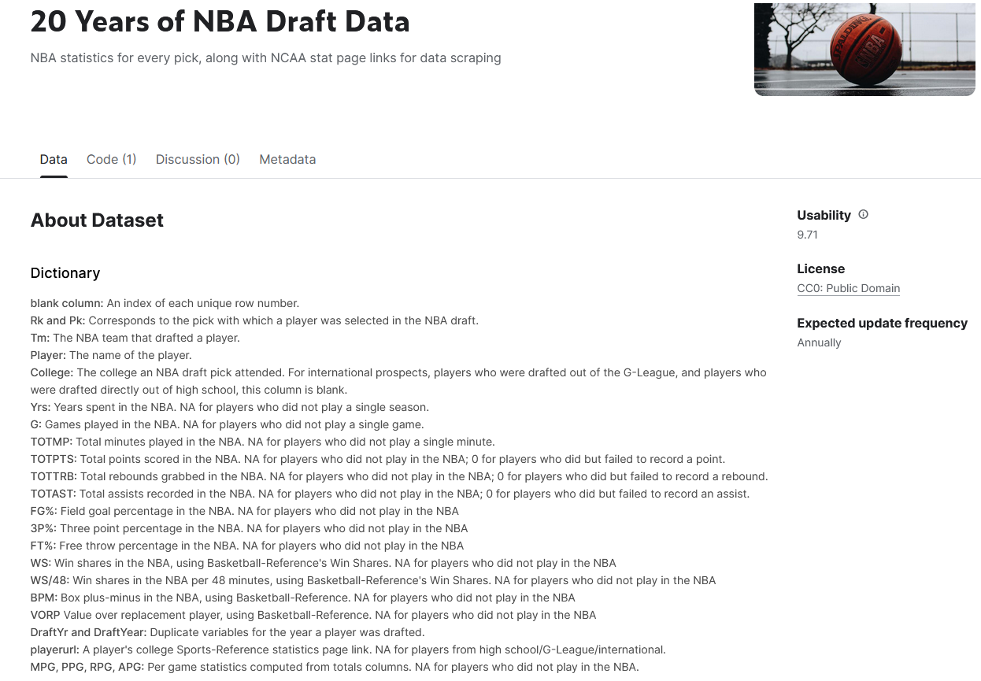
The Data
Source: https://www.kaggle.com/datasets/benwieland/nba-draft-data

Slide 6

Analysis Total points scored
First picks clearly show overperformance in terms of Total points scored along the players’ careers
Choosing a top ten draft pick seems like a good decisión for Team´s scored points contribution

Slide 7
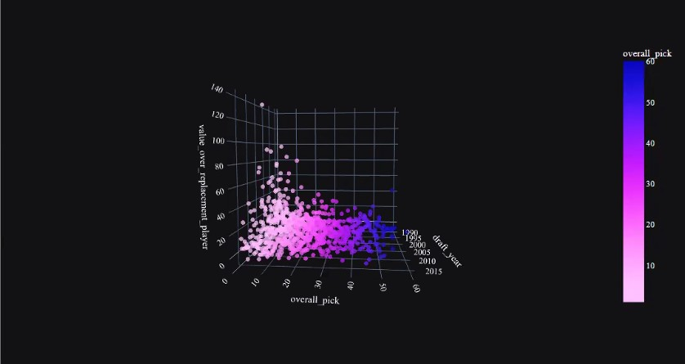
Analysis Value over replacement player
Value over replacement player shows the impact on Team performance when a player is not on the court
(“The suffering Index”)
VORP confirms previous analysis and shows a clear relation between the Draft´s pick and the importance of a player within his team
The top ten players of their Drafts have a greater impact on their teams performance than the others

Slide 8
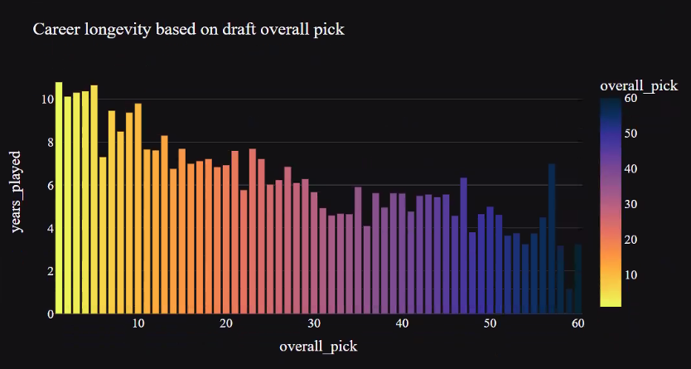
Analysis Career Longevity
Top 10 selections on Draft have longer careers
Longer careers on such a competitive enviroment suggests that the player has sufficient quality to survive even in years of underperformance

Slide 9
Conclusions
Is it worthwhile to have a selection among the first fifteen positions?
Our research shows that:
Players selected from top positions on Draft perform better on Points scored and Team impact along their professional career at the NBA
Career longevity shows a relationship with Draft Pick. In our opinión this is an indirect measure of Player´s Quality as we asume that NBA is a Darwinian environment, highly competitive were long careers are only available for high performing players
Based on the analysis of this data we conclude that picking players from the top positions on the Draft has a positive impact for the Teams

